Slide 1
PACKAGING UNIT
PP-HDPE WOVEN BAGS

Slide 2
Overview of PP/HDPE Industry
PP/HDPE woven bags is a volume based business and its units need to be evaluated on the following parameters.
Capacity V/S investment per unit.
Power consumption per MT output.
Source/ make of equipment and quality norms.
Manpower cost, inputs, logistics, other running costs, which determine profitability.
Marketing, present and future.
Long term viability and plans of the Company.

Slide 3
Business Overview
ISO 9000 certified Company
An established profit making Manufacturing Unit of PP-HDPE WOVEN BAGS
Commissioned in 1984 to manufacture circular woven PP/HDPE fabrics and bags, both laminated and un-laminated
Located at incentive Benefits zone at Una in Himachal Pradesh
Operating since 1986
Plant expansion in 1997.
Consolidated all operations at Una in 2007
Operations modernized with high capacity tape Line and looms in 2013

Slide 4
Infrastructure
Company has two units (next to each other)
Unit 1 – supply to those companies, taking Cenvat credit
Unit 2 – supply to others companies who do not require Cenvat credit
Unit 1 – 3720 sq meters
Unit 2 – 2940 sq meters.
Total covered area = 61,000 sq.ft

Slide 5
Plant and Machinery
Using Most Modern Machines.
Best Machines Available from Granules to Bag Manufacturing.
CAPACITY
Capacity of both units put together is 7000 mt
A yearly Sales potential of Rs. 80 crs a year.
Original – 3000 mt - Turn over Rs.33 crs
Enhanced – 7000 mt – Turn over (potential) Rs.80 crs
POWER CONNECTIONS
UNIT1 – 882 KW
UNIT 2 – 200 KW being increased to 495 KW

Slide 6
Plant and Machinery (cont.)
The investment in plant and machinery from FY 2009-10 to FY 2017-18 has been Rs 5,10,66,000.
Further, machines worth another Rs 50,00,000 are expected to be added during the current FY.

Slide 7
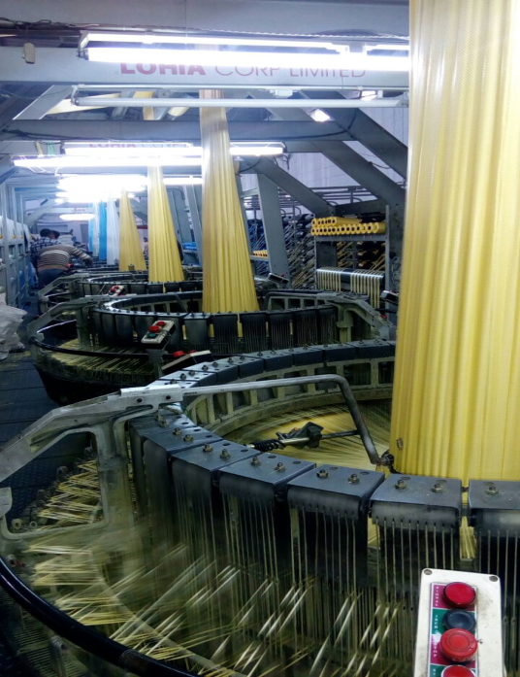
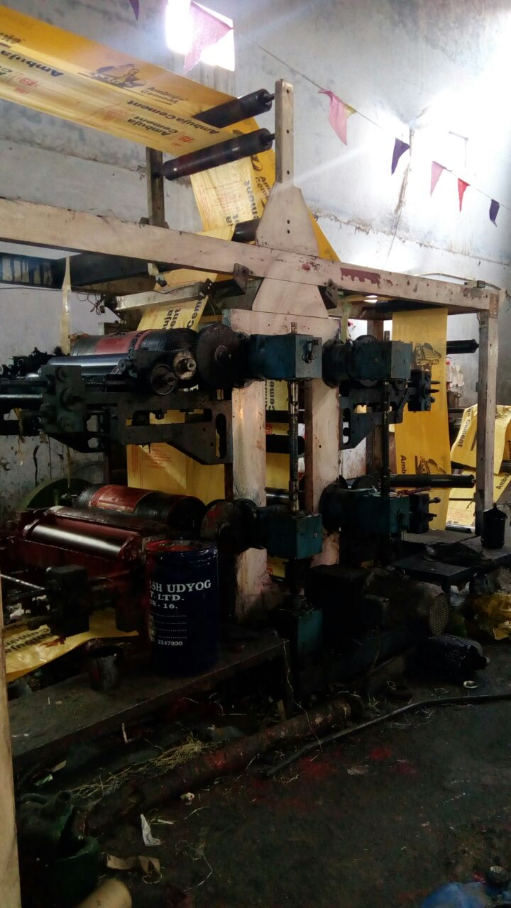
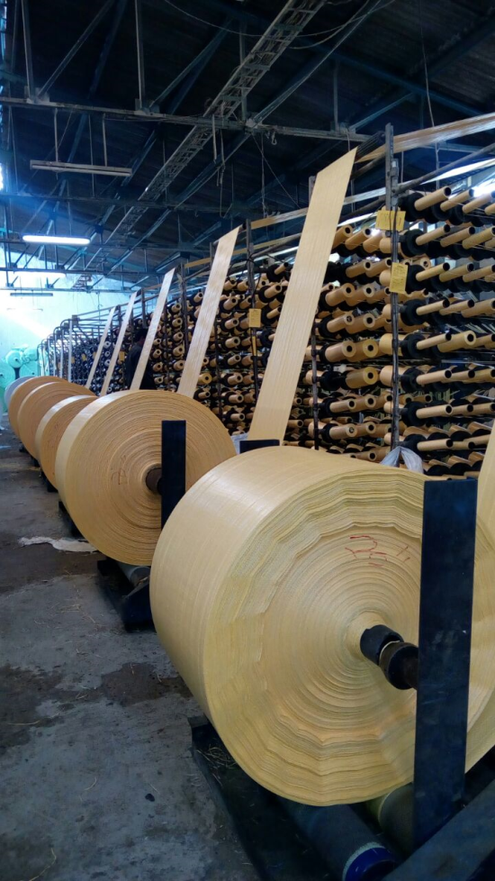
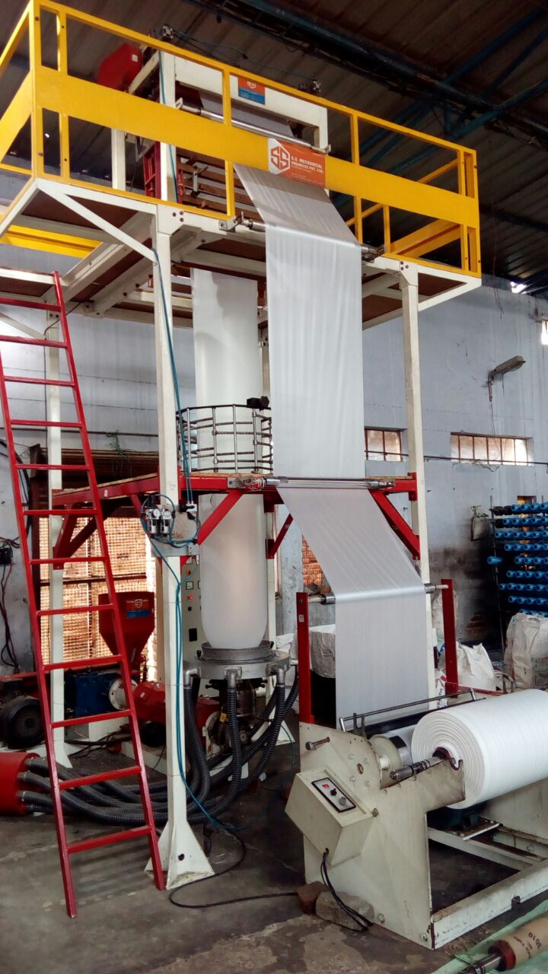
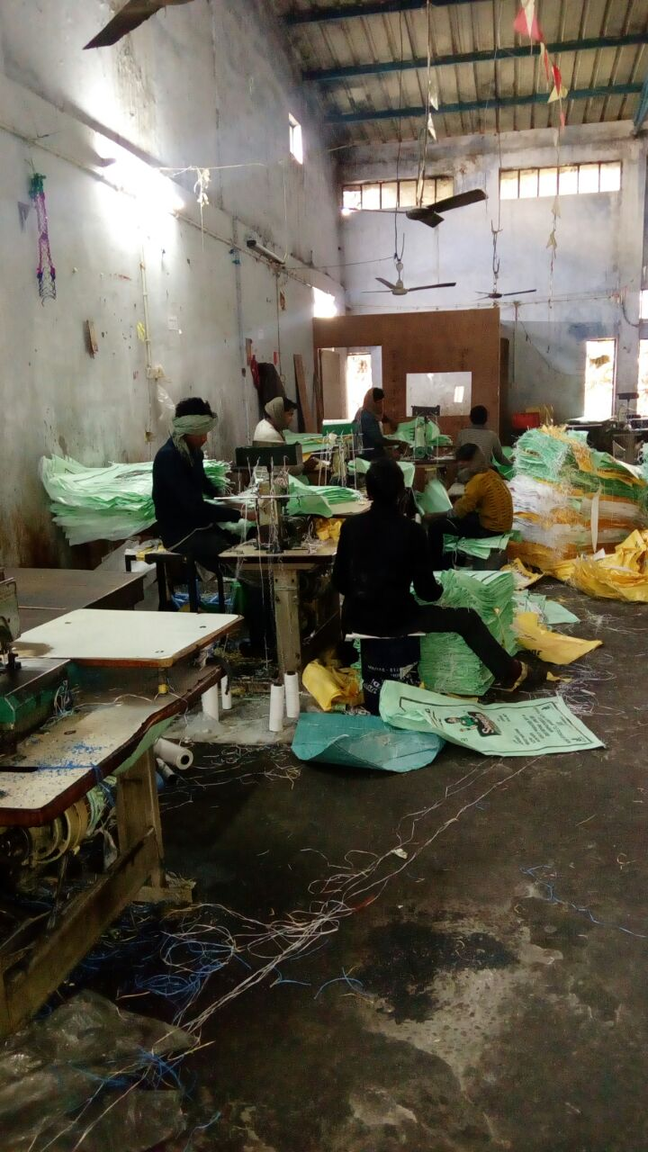
Glimpse of the Machinery

Slide 8
Clients
ACC cement
Ambuja cement
Varadhman group
RIL
Saraswati sugars group
Indian Sucrose Limited
Indian Acrylics Ltd

Slide 9
Clients
The Company is also registered and has a rate contract with DGS&D for supply of Food grain bags, which has huge potential for us as Punjab and Haryana are its larges consumers.
The Company has enough orders even out matching its capacity at times.

Slide 11
Financials
For The Last 4 Year –Rs In Lacs
2009-10 2010-11 2011-12 2012-13
NET SALES 2322 2470 3006 2878
EBITDA 135 105 110 120
PBT 53 8 15 26

Slide 12
Financial Parameters
Sales to Market value of Assets Ratio
3.5%
Current Ratio
1.25/1.3
Inventory Turnover Ratio
10 Times
Debtors at 40 days

Slide 13
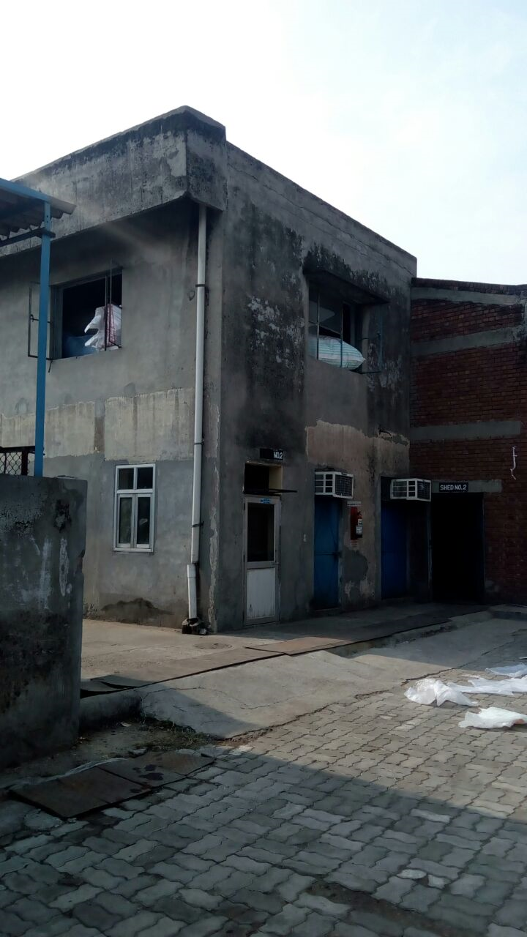
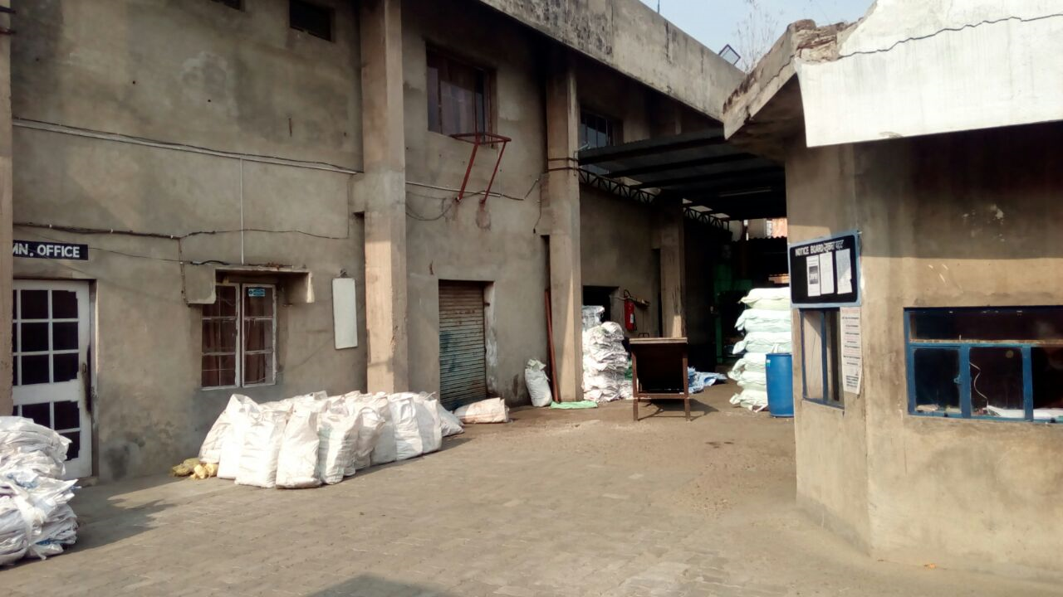
Glimpse of the units

Slide 14
STRENGTHS
Capital Investment Subsidy in Unit 2.
Regular Supply of Power.
DGS&D rate contract for Food Grade Bag Supply.
10 year income tax exemption as applicable to Industry in Himachal Pradesh.

Slide 15
Weaknesses
He as a promoter has been working single handedly.
Shortage of money and needs more working capital funds.
Many capital acquisitions were funded from working capital

Slide 16
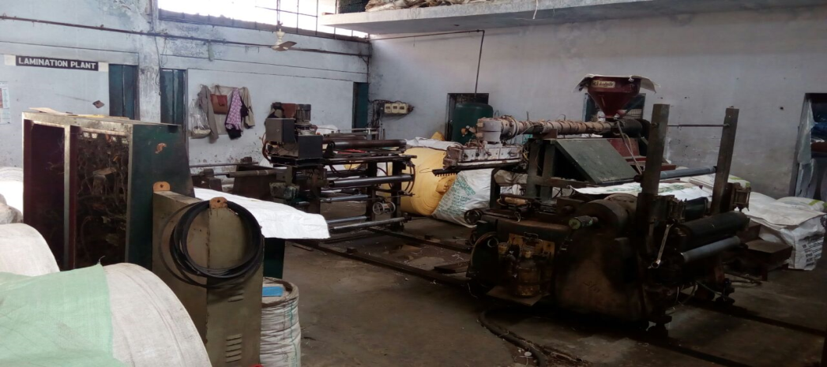
Opportunities
A Lamination plant is lying closed, which if recommissioned can produce milk powder packing bags, Rice packing bags and Pet feed packing bags.
The Lohia tape line is lying closed at present, once started the unit has a potential to achieve gross sales of Rs 70 to 75 crores.

Slide 17
Threats
Internal Rivalry is High
New entrants face difficulty till they have a substantial clientage in hand
Unorganized nature of Industry
Threat of substitutes like glass, PHB Biocomposites, Liquid Wood, ECM Biofilm
Ever increasing prices of crude oil

Slide 18

Thank You
Contact us at:
505, Manisha Building 75-76, Nehru Place, Delhi-19
91-11-4106 4800 | 9811 568 568
enquiry@businessdeals.in | www.businessdeals.in

